Slide 1
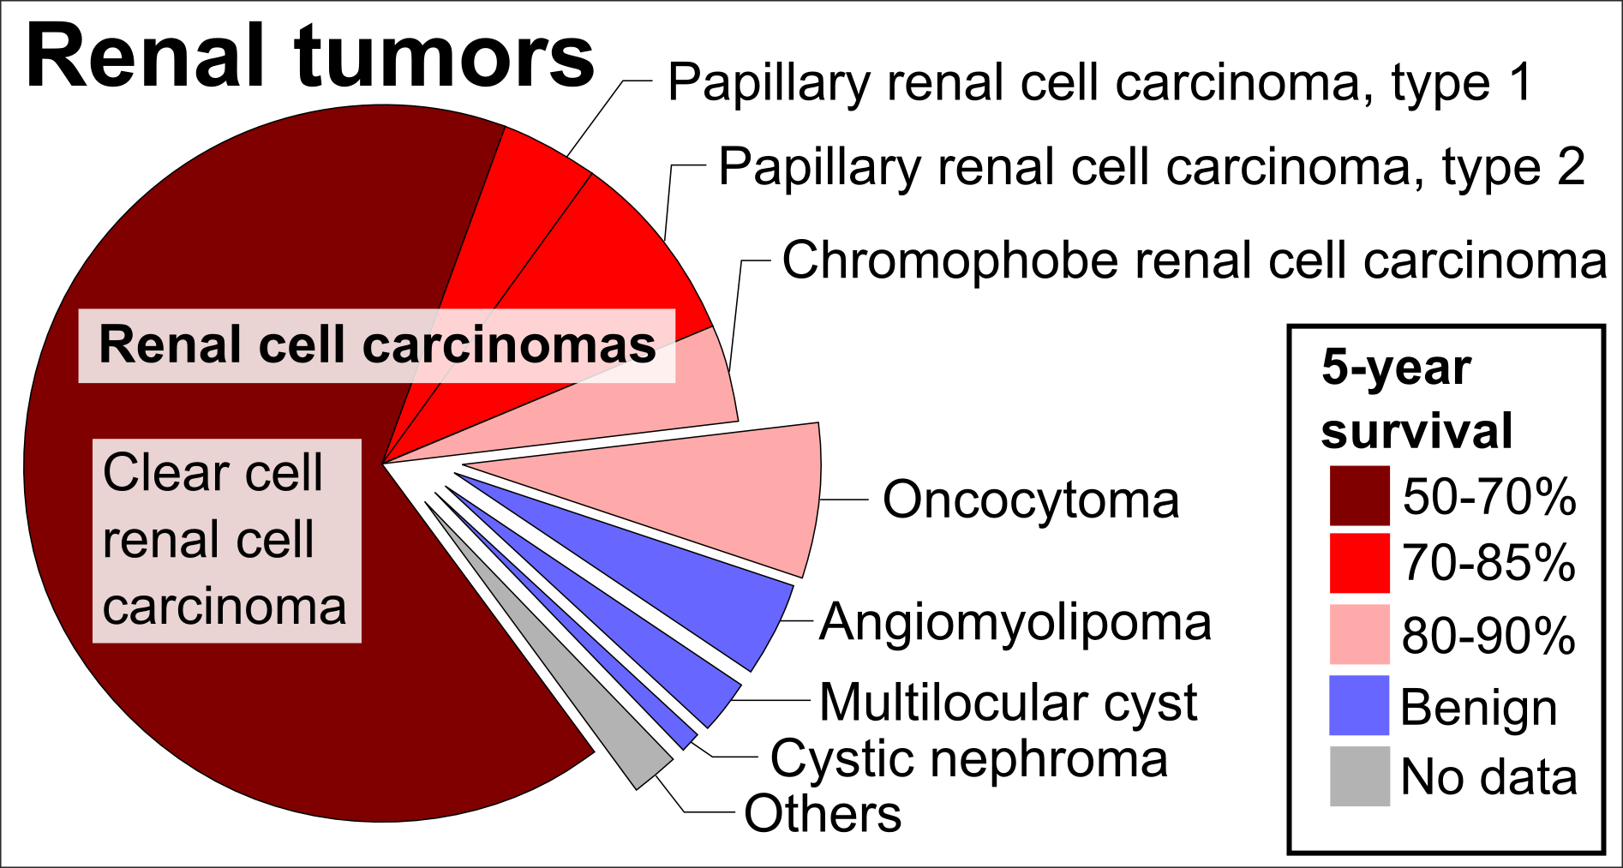
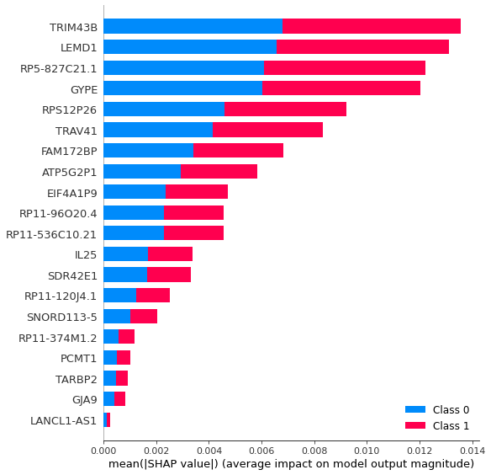
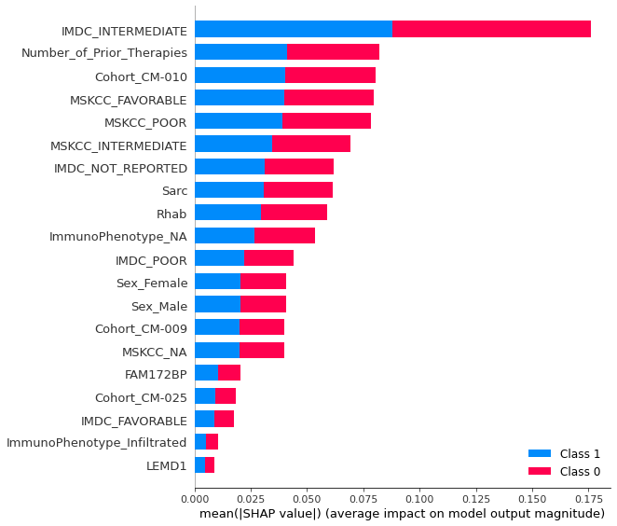
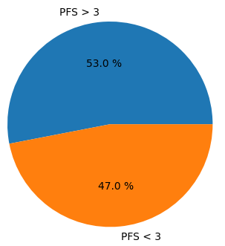
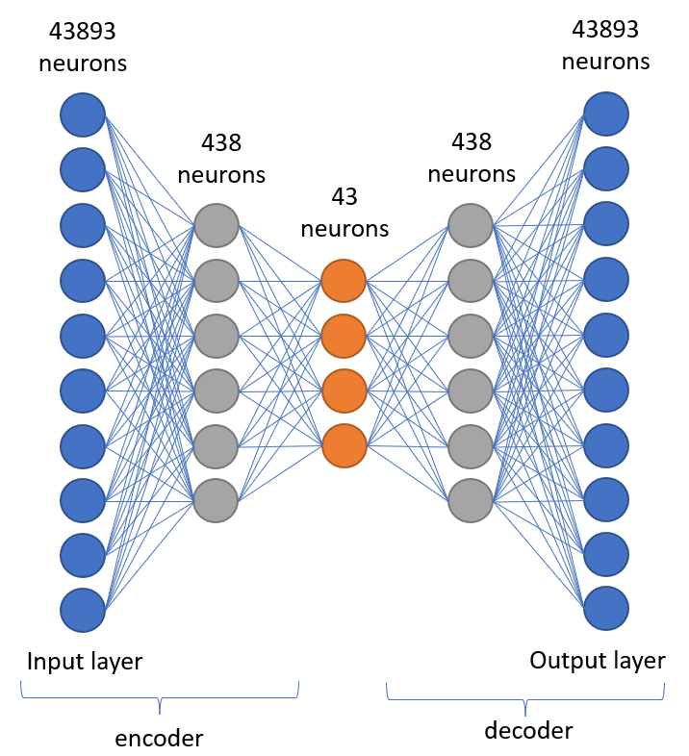
Evaluation of deep learning techniques in RNA sequencing data
for the prediction of patient response to antiangiogenic treatment
Authors:
Background:
Antiangiogenic treatments have demonstrated to improve PFS and OS for metastasis Renal Cell Carcinoma (mRCC) patients in several phase III clinical trials.
Current search lines are using genomic and transcriptomic data
to identify predictors of response to treatments.
Since healthcare domain data sets
are heterogeneous and
high-dimensional Deep learning
(DL) approaches appear to be a
consolidated solution to this
problem.
Does our model obtained for NIVOLUMAB treatment really shows the response to the drug?
Yes, concretely the ML classifier which achieved the best result in terms of accuracy was logistic regression classifier with 86.4% of hit rate.
Are deep learning models the most effective methods for predicting response to NIVOLUMAB treatment?
DL methods have not demonstrated to be significantly better than traditional ML methods, when predicting the response of patients.
Author contact: sanalo05@ucm.es
Results:
Most relevant genes for the decision making were related with the immune response and the regulation of kinase which meets the biological explanation. However interpretability results revealed that clinic features seemed to have more relevance when making the decision.
(a) (b)
Model | Data set | Accuracy
Logistic regression | 30 most reliable genes and MSKCC variable. | 0,864
Deep autoencoder + Decision tree | 30 most reliable genes and 12 clinic variables. | 0,689
CNN | 400 most reliable genes | 0,541
Figure 1:Distribution of renal tumours by relative incidence and prognosis. Author Mikael Häggström.
Methods:
Data set: clinical and immune phenotype data and RNA expression (43893 genes) of 181 patients treated with NIVOLUMAB, an antiangiogenic treatment.
Procedure:
Creation of 8 data set using combinations
of the information above and classification
of patients by their clinical benefit (CB)
using their PFS: CB (PFS < 3m) and no CB
(NCB) (PFS > 3m).
We compared a generative model
(deep autoencoder) and a
discriminative model (CNN) with
traditional machine learning (ML)
models.
We came up with an
interpretability analysis of those
black-box models using LIME and
SHAP values.
Figure 2: Patients distribution based on their clinical benefit.
Figure 4: Interpretability results using SHAP values for (a) RNA data and (b) clinic and RNA data.
Future Directions for Research:
Collect data from more patient samples whose PFS is over 6 months.
Continue studying more innovative DL techniques.
Figure 3: Deep autoencoder structure.
Notes:
Poster Template using Individual Text Boxes

